Slide 1


Blueskysea User Interface Project
Jordan Loudis, Forrest Moulin, Logan Pratt, and Brianna Price
Pennsylvania State University
IST331-002: The Foundations of Human Centered Design
Instructor Robert Godshalk

Slide 2



Project Overview
Introduction
Original Interface Design
Redesigned Interface
Conclusion

Slide 3
Introduction: Blueskysea Dashcam
Application Overview
User profiles
Personas
Scenarios

Slide 4
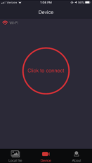
Original Interface: Device
The original application interface is a dark, blank screen that prompts the user to "Click to connect".
There is no splash screen for "Device" – the interface loads the device screen as soon as the application is launched and asks the user to connect to a device.
The user must manually connect to the device to view live video even when already connected to the dashcam's Wi-Fi network.

Slide 5
Original Interface: Device Cont'd
Wi-Fi is connected but the user still must press the click to connect button
Located in the middle of the navigation bar

Slide 6
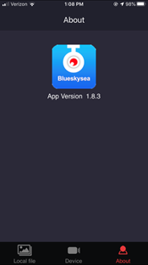
Original Interface: About
The original About interface is pretty much nonexistent.
The only information on the original interface is the current app version as well as the logo of the application.
There is no information about the actual upgrades that were made to the device and no information about anything related to the application.

Slide 7
Original Interface: About Cont'd
Little to no information on the about screen
About screen is located on the right-hand side of the navigation bar

Slide 8
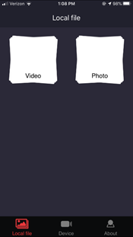
Original Interface: Local file
The "Local file" screen consists of two buttons, the video files and the photo files.
This screen allows the users to view their videos or photos that are on their local devices.
When the device is connected, the user can save a photo or video on the SD card to their device via the Local file screen.
This original design is basic and provides the user with little direction. Additionally, the file in "Local file" is not capitalized, which is inconsistent with other titles.

Slide 9
Original Interface: Local file Cont'd
The Local file screen is located on the left-hand side of the navigation bar

Slide 10
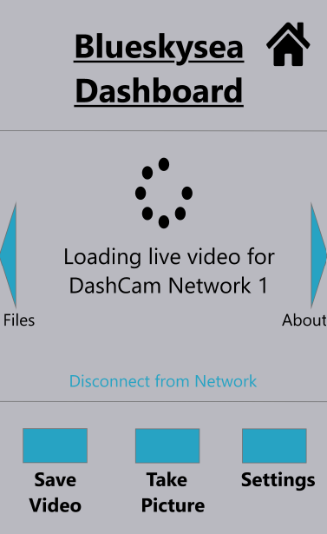
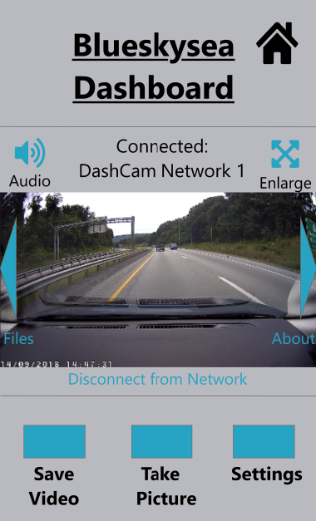

Redesigned Interface: Dashboard Screens
New additions to the Dashboard interface:
Loading icon
Icons provide visual cues
Notable Heuristics
#1 – Visibility of System Status
#6 – Recognition over recall
#7 – Flexibility and efficiency of use

Slide 11
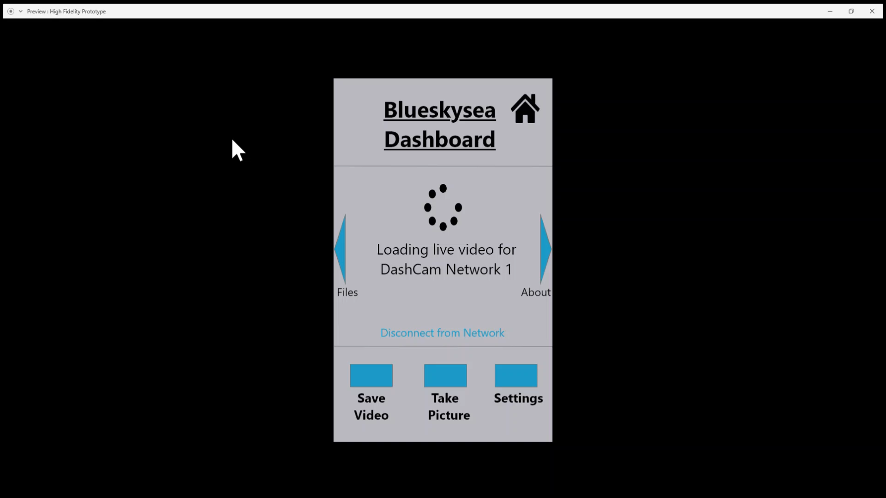
Redesigned Interface: Dashboard Loading

Slide 12
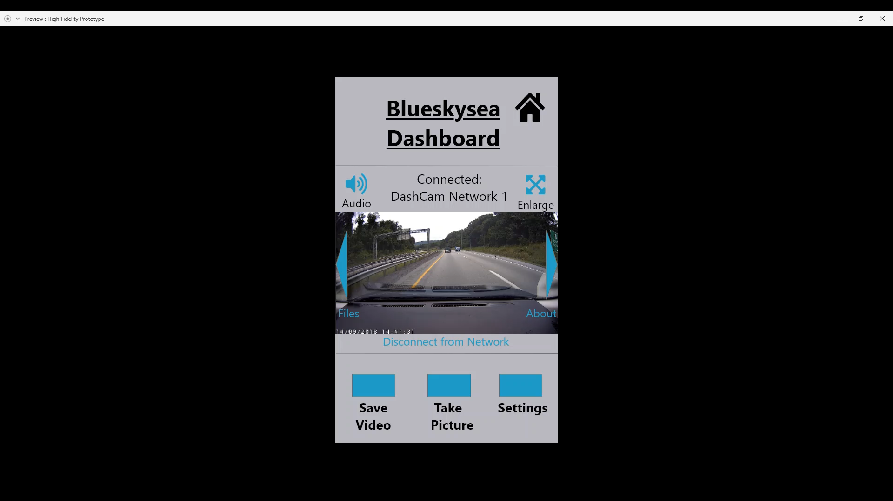
Redesigned Interface: Dashboard Loaded

Slide 13
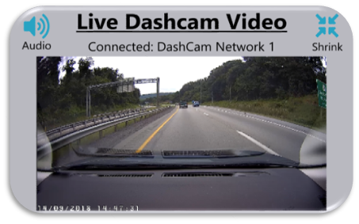
Redesigned Interface: Enlarged Video
Audio icon
Shrink video
Notable Heuristics
#1 – Visibility of system status
#3 – User control and freedom

Slide 14
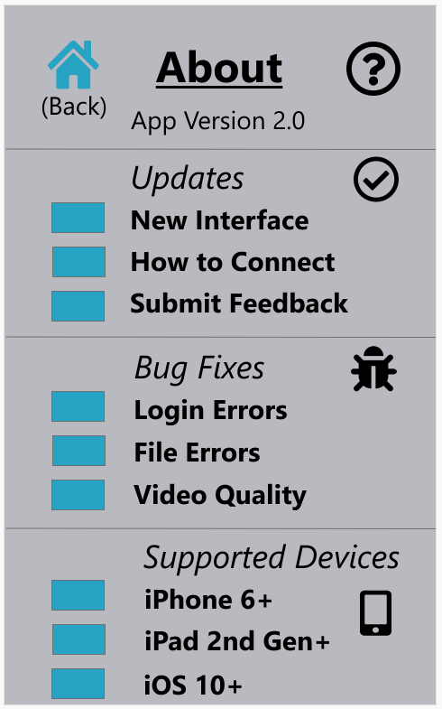
Redesigned Interface: About Screen
New grouping editions
Informative
User diversification by providing specific settings
Notable Heuristics
#6 – Recognition over recall
#10 – Help and documentation

Slide 15
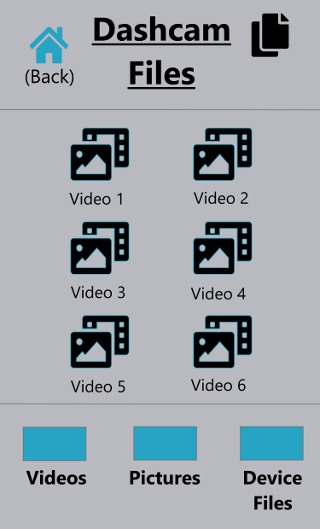
Redesigned Interface: Files Screen
New additions to the Dashcam Files:
Automatically display selectable videos
Heuristic #2 – Match between the system and the real world
Removal of "Local files" and "clips" verbiage
Intuitive icons
Heuristic #4 – Consistency & standards
Home (Back)
Layout and theme
Blue-green buttons

Slide 16
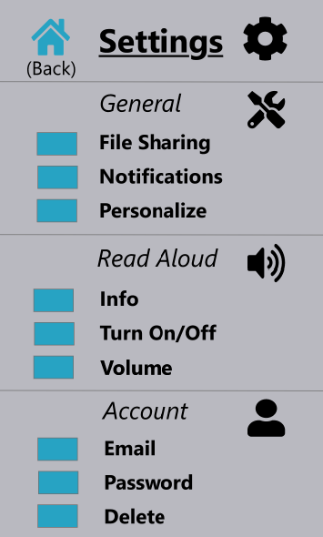
Redesigned Interface: Settings Screen
Addition of the Settings interface:
Sections are grouped
Icons provide visual cues
Notable Heuristics
#6 – Recognition over recall
#10 – Help and documentation
#3 – User control and freedom

Slide 17
Conclusion
Examined original Blueskysea interface design
Proposed and implemented design changes
Gathered usability testing data
Enhanced prototype

